Slide 1
Neutrosophic Topological Space in Medical Diagnosis
Dr. M. Parimala
Department of Mathematics,
Bannari Amman Institute of Technology,
Sathyamangalam.
Presented at SNS college of Engineering
International Faculty Development Programme on
“Astute-Efflux Trends in Mathematics“
2nd July 2020

Slide 2
Uncertainty:
The world is not all in black and white, A or B, true or false.
There are degrees of correctness somewhere in the middle
Do you want to eat, yes or no?
    I’m a little hungry, but not starved.
Do you believe me or not?
    I’m not entirely convinced.
Is he a tall man?
    I guess he’s tall, but not that tall.
What color is that?
    Kinda blue, kinda green.

Slide 3

Enter “fuzzy logic.”
Dr. Lofti Zadeh developed the theory
of binary logic in 1960s, when he was
a professor at the University of California at Berkeley.
Dr. Zadeh wanted to find a way for a computer to see a problem in the way a human would. He determined that the binary codes “0” and “1” represented extremes,
fuzzy logic algorithms to identify those “in-between” areas. Mathematical sets addressed “if this, then do this.” For each step in the decision process, the sensor uses fuzzy logic to do the thinking.

Slide 4
Fuzzy sets
Fuzzy set helps to describe the imprecise data. (i.e) uncertain data's
One may say fuzzy set theory and probability theory are same.
But exactly not. In probability theory we exactly knew the total occurrence and possible event. (i.e. set
of all well defined objects)
In general,
probability theory deals with a collection of well-defined events and predicts the chance of occurrence of each event.
fuzzy set theory deals with a collection of vague events and describes the degree of belongingness for each event.

Slide 5
Definition: Fuzzy set
Let X be a non-empty set. A fuzzy set A in X is characterized by its membership function μ_{A} :X→[0,1] is interpreted as the degree of membership of element μ_{A}(x) in fuzzy set A, for each x ∈ X. It is clear that A is completely determined by the set of tuples
A = {(x, μ_{A} ) : x ∈ X}.

Slide 6
Examples of fs
Air Conditioning.
    In today’s HVAC systems, fuzzy logic doesn’t rely on the two “extremes”. It manages the temperature to remain steady. By sensing slight fluctuations and making adjustments, the air conditioning system is more energy-efficient.
Washing Machines.
    sense how heavy a load is and determine the correct amount of water and detergent, speed of agitation, and length of the wash cycles.
TVs, Cooking and very many places

Slide 7
Intuitionistic Fuzzy Set
Intuitionistic fuzzy set theory developed by K. Attanassov, in 1975.
The imprecise data has non-membership value. K. Attanassov generalise the fuzzy set as order doublets.
Each Intuitionistic set have both membership and non-membership.
Intuitionistic fuzzy sets generalize fuzzy sets, since the indicator functions of fuzzy sets are special cases of the membership and non-membership functions μ and ν(or)π of intuitionistic fuzzy sets, in the case when the strict equality exists:π=1- μ, i.e. the non-membership function fully complements the membership function to 1, not leaving room for any uncertainty.

Slide 8




Definition: Intuitionistic fuzzy set
Let X be a non-empty fixed set. An intuitionistic fuzzy set (IFS for short) A is an object having the form
where the functions and denote the degree of membership and the degree of non-membership of each element x ∈ X to the set A, respectively, and 0 ≤ ≤ 1, for each x ∈ X.

Slide 9
Example of IFS
Tea is served to you, it is neither too hot nor too cold. you can say 70 percentage it is hot then it is understood that 30 percentage is cold.
Here hot refers membership function and
cold refers non-membership function.
But sum of membership and non-membership should be less than or equal to 1. so the above case can be written as membership of hot tea is 0.7 and non-membership of hot tea is 0.2.
In medical field the degree of association and the degree of non-association between symptoms and diagnosis.

Slide 10
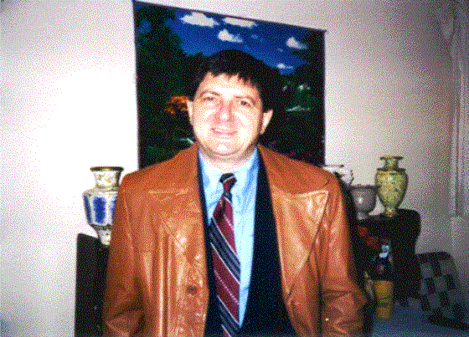
Florentin Smarandache
polymath, professor of mathematics
University of New Mexico, 705 Gurley Ave., Gallup, New Mexico 87301, USA

Slide 11
Founder of Neutrosophic Logic(Set)
In 1995, he generalized framework for unification of many existing logics, such as fuzzy logic, paraconsistent logic, intuitionistic logic, etc. The main idea of NL is to characterize each logical statement in a 3D Neutrosophic Space, where each dimension of the space represents respectively
1) the truth (T)
2) the falsehood (F) and
3)the indeterminacy (I)
of the statement under consideration, where T, I, F are standard or non-standard real subsets of ]⁻0, 1⁺[ with not necessarily any connection between them.

Slide 12
Webpage and journal
Home page link:
http://fs.unm.edu/FlorentinSmarandache.htm
Journal link:
http://fs.unm.edu/NSS/
broumi said - International Journal of Neutrosophic Science http://americaspg.com/journals/show/21

Slide 13
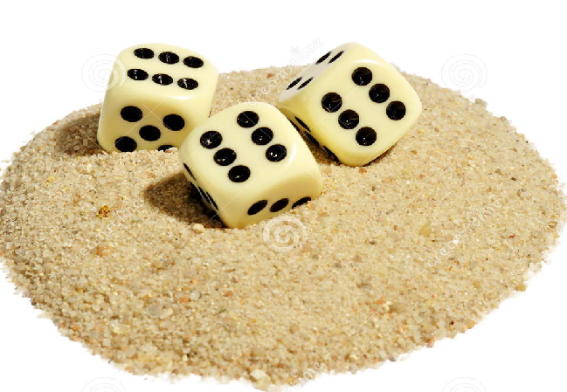

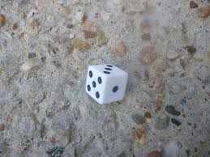

Example of ns

Slide 14
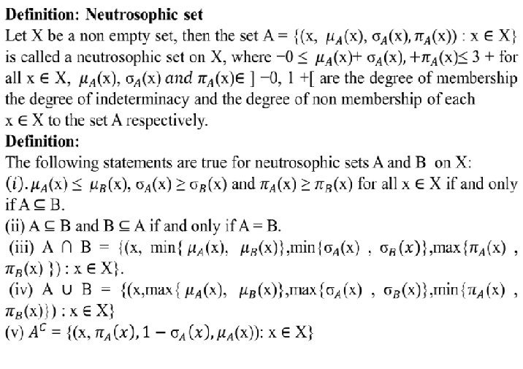

Slide 15
example to understand the indeterminacy and neutrosophic logic
In a given mobile phone suppose 100 calls came at end of the day.
1. 60 calls were received truly among them 50 numbers are saved and 10 were unsaved in mobile.
  60 calls will be the truth membership i.e. 0.6.
2. 30 calls were not-received by mobile holder. Among them 20 calls which are saved in mobile contacts were not received due to driving, meeting, or phone left in home, car or bag and 10 were not received due to uncertain numbers.
  30 not received will be the Indeterminacy membership i.e. 0.3.
3. 10 calls were those number which was rejected calls intentionally by mobile holder due to behavior of those saved numbers, not useful calls, marketing numbers or other cases for that he/she do not want to pick or may be blocked numbers
  10 rejected will be the false i.e. 0.1 membership value.

Slide 16
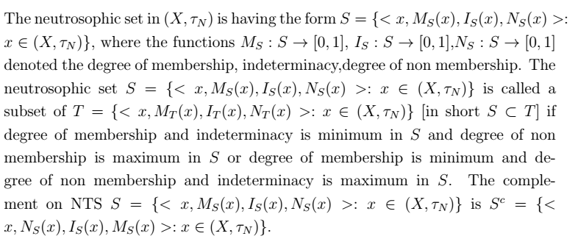
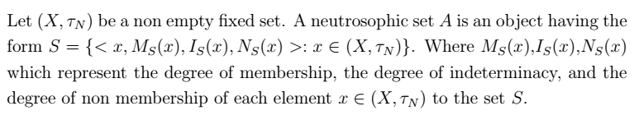
preliminaries

Slide 17
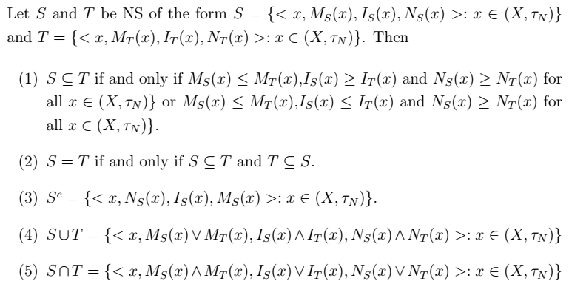
Basic properties of ns

Slide 18
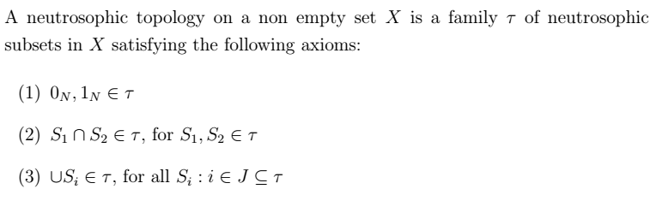
Neutrosophic topology

Slide 19
example
Let X ={x} and A={0.5,0.5,0.4 }, B ={0.4,0.6,0.8 }
D={0.5,0.5,0.4} and C= {0.4,0.6,0.8 }
Then the family (X,τ )= {1_{N},0_{N}, A, B, C, D}of NSs in X is neutrosophic topology on X.
Each set in τ is an open set and its complements are closed set.

Slide 20
Basic definitions
Definition: Neighbourhood
A neutrosophic set A is a neighbourhood of neutrosophic set B if there exist an open set C such that B ⊂ C ⊂ A.
Definition: Interior and closure
Let (X,τ_{N} ) be a neutrosophic topological space and S = {(x, M_{s}(x),I_{s}(x), N_{s}(x)) : x ∈ X} be a neutrosophic set in X.
Then the neutrosophic closure and interior of A are defined by
Ncl(S)= min {F: F is an Neutrosophic closed set in X and S⊂F}
Nint(S)= max{F: F is an Neutrosophic open set in X and F⊂S}

Slide 21
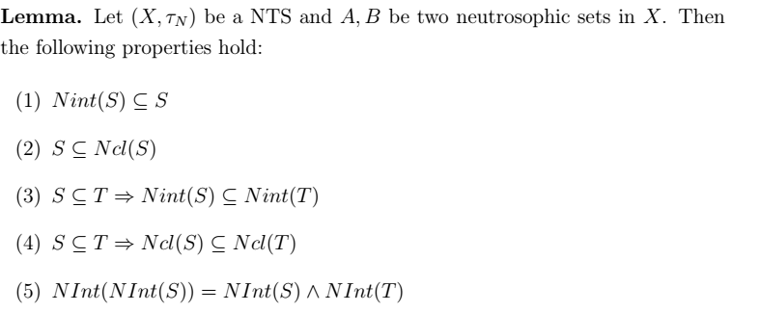
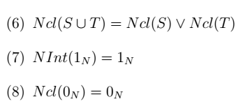

Slide 22
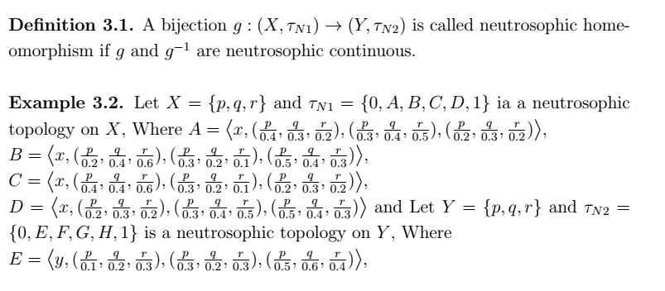
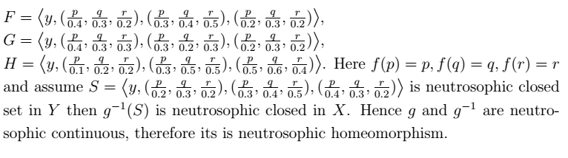
3. Neutrosophic homeomorphism

Slide 23
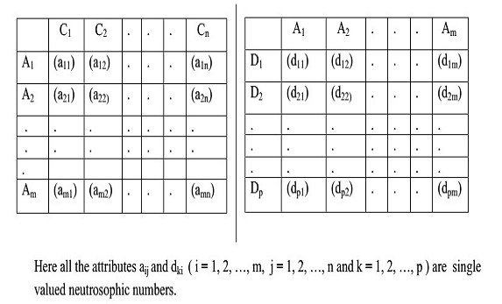
Neutrosophic Topology in Data analysis
Decision-making problem with single valued neutrosophic information. The following necessary steps are proposed the methodical approach to select the proper attributes (As &Ds) and alternatives (Cs) in the decision-making situation.

Slide 24
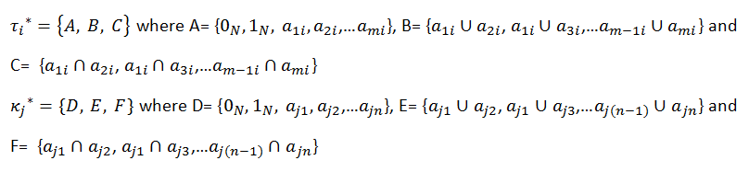
Algorithm
Step 1: Problem field selection:
Consider multi-attribute decision making problems with m attributes A₁; A₂; :::; A_{m} and n alternatives C₁; C₂; :::; C_{n} and p attributes D₁; D₂; :::; D_{p}, (n ≤ p).
Step 2: Form neutrosophic topologies for (C_{j} ) and (D_{k}):

Slide 25


Step 3: Find Single valued neutrosophic score functions: neutrosophic score functions (shortly NSF) of A, B, C, D, E, F C_{j} and D_{k} are defined as follows.

Slide 26
Step 4: Final Decision Arrange single valued neutrosopic score values for the alternatives C₁ ≤ C₂ ≤ ::: ≤ C_{n} and the attributes D₁ ≤ D₂ ≤ ::: ≤ D_{p} . Choose the attribute D_{p} for the alternative C₁ and D_{p-1} for the alternative C₂ etc. If n<p, then ignore D_{k} , where k = 1; 2; :::; n − p.

Slide 27
Application in medical diagnosis
The process of classifying different set of symptoms under a single name of a disease is very difficult.
In some practical situations, there exists possibility of each element within a periodic form of neutrosophic sets.
So, medical diagnosis involves more indeterminacy. neutrosophic sets handle this situation. Actually this approach is more flexible, dealing with more indeterminacy areas and easy to use. The proposed topological measure is among the patients versus symptoms and symptoms versus diseases will provide the proper medical diagnosis in neutrosophic environment.

Slide 28
Step 1: Problem field selection:
Consider the following tables giving informations when consulted physicians about four patients P1; P2; P3 and symptoms are fever, headache, cold, cough . We need to find the patient and to find the disease such as Dengue, Malaria, Flu of the patient.
Let P = {P₁, P₂, P₃} be a set of patients, D ={Dengue, Malaria, Flu } be a set of diseases and S = {fever, headache, cold, cough } be a set of symptoms.

Slide 29
Table 1: (Relation-1) the relation between Patients and Symptoms in neutrosophic form
Relation-1: Patients/Symptoms
Relation-1 | p1 | P2 | p3
fever | (0.8,0.2,0.2) | (0.1,0,0.7) | (0.9,0.1,0)
headache | (0.1,0.2,0.7) | (0.1,0.1,0.8) | (0,0.3,0.7)
cold | (0.8,0,0.2) | (0.2,0.1,0.6) | (0.3,0.1,0.6)
cough | (0.3,0.2,0.5) | (0.9,0,0.1) | (0.4,0.3,0.2)

Slide 30
Table 2: (Relation-2) The relation among Symptoms and Diseases in neutrosophic form
Relation-2: Symptoms /Diagnosis
Relation-2 | Fever | Headache | Cold | Cough
Dengue | (0.6,0.4,0.2) | (0.4,0.4,0.3) | (0.3,0.4,0.4) | (0.6,0.5,0.3)
Malaria | (0.7,0.4,0.5) | (0.4,0.6,0.3) | (0.5,0.4,0.4) | (0.6,0.4,0.4)
Flu | (0.5,0.5,0.5) | (0.5,0.4,0.4) | (0.4,0.4,0.4) | (0.4,0.5,0.2)

Slide 31
Step-2
Topologies for Table 1
τ₁*= {A,B,C}= {(0,1,1),(1,0,0)(0.8,0.2,0.2),(0.1,0.2,0.7),(0.8,0,0.2),(0.3,0.2,0.5)}
τ₂*= {A,B,C}= {(0,1,1),(1,0,0)(0.1,0,0.7),(0.1,0.1,0.8),(0.9,0,0.1),(0.2,0.1,0.6), (0.2,0,0.6),(0.1,0,0.8)}
τ₃*= {A,B,C}= {(0,1,1),(1,0,0)(0.9,0.1,0),(0,0.3,0.7),(0.3,0.1,0.6),(0.4,0.3,0.2),(0.4,0.1,0.2),(0,0.1,0.7),(0.4,0.1,0.2),(0,0.3,0.7)}

Slide 32
Topologies for Table-2
κ₁*={D,E,F}= {(0,1,1),(1,0,0),(0.6,0.4,0.4),(0.4,0.4,0.4),(0.3,0.4,0.4),(0.6,0.5,0.3)}
κ₂* = {D,E,F}= {(0,1,1),(1,0,0),(0.7,0.4,0.5),(0.4,0.6,0.3),(0.5,0.4,0.4),(0.6,0.4,0.4),(0.7,0.6,0.3),(0.7,0.4,0.4),(0.5,0.6,0.3),(0.6,0.6,0.3),(0.4,0.4,0.5),(0.5,0.4,0.5),(0.6,0.4,0.5),(0.6,0.4,0.5),(0.5,0.4,0.4)}
κ₃*= {D,E,F}= {(0,1,1),(1,0,0),(0.5,0.5,0.5),(0.5,0.4,0.4),(0.4,0.4,0.2),(0.4,0.5,0.2),(0.5,0.5,0.4),(0.5,0.5,0.2),(0.5,0.4,0.2),(0.5,0.4,0.5),(0.4,0.5,0.5),(0.4,0.4,0.4),(0.4,0.4,0.2)}

Slide 33
Step - 3
Neutrosophic score function (NSF)
From Topologies of attributes
C1=0.7278, C2=0.50553, C3=0.5685
From Topologies of decision
D1=0.5388, D2=0.5559, D3=0.7379

Slide 34
Step - 4
Final decision
Arrange C’s and D’s in ascending order.
Patient 1 suffers from Dengue
Patient 2 suffers from flu and
Patient 3 suffers from malaria.

Slide 35
Conclusion
Neutrosophic topological space is one of the research areas of generalized fuzzy topological spaces to deal the concept of vagueness.
This work introduced neutrosophic topological spaces and its real life application.
This theory can be developed and implemented to other research areas of general topology such as rough topology, digital topology and so on.

Slide 36
Neutrosophic set application in different fields
Psychology
Sociology
Civil engineering
Information Technology
Linguistics
Probability & Statistics
Calculus
Algebra
Topology
Graph theory
Decision making
  & many more

Slide 37
References
L. A. Zadeh. Probability measures of fuzzy events, Journal of Mathematical Analysis and Applications, 23 (1968), 421–427.
K. Atanassov. Intuitionistic fuzzy sets, Fuzzy Sets and Systems, 20(1986), 87–96.
F. Smarandache. Neutrosophic set, a generalization of the intuituionistics fuzzy sets, Int. J. Pure. Appl. Math., 24 (2005), 287–297.
F. Smarandache and S. Pramanik. New trends in neutrosophic theory and applications, Brussels, Belgium, EU: Pons Editions
(2016)
A. A. Salama and S. A. Alblowi. Neutrosophic Set and Neutrosophic Topological Spaces, IOSR Journal of Mathematics, 3(4)(2012), 31–35.
A. A. Salama, F. Smarandache and Valeri Kroumov. Neutrosophic Crisp Sets and Neutrosophic Crisp Topological Spaces, Neutrosophic Sets and Systems, 2 (2014), 25–30.

Slide 38

Any Questions

Slide 39



